Slide 1

Visualization and Analysis Project
This describes the Visualization-and-Analysis Project and Git repo
Three data versions: 1, 2, ‘H’
What are the current GitHub branches?
Major Functions
Map Visualization
Meridional (latitudinal) analysis
Zonal (longitudinal) analysis
Extrema identification and analysis
Region of interest analysis
Threshold segmentation and analysis
ML Analysis – unsupervised Gaussian Mixture Model (GMM)
Supporting functions (FITS reading, catalog support)

Slide 2
Map Visualization
Visualization
Primary f_{NH3} and P_{Cld} Data – 3 types: Version 1 SCT, Version 2 SCT, HST
Primary tricolor context imaging
Secondary data maps (889 CH₄, 5-μm)
3D surface map plots
Supporting information and functions
Color bars and adjustable scales
Contour overplotting
Global data statistics
Primary calls from
L3_Jup_Map_Plot_V2
L4_Jup_Map_Plot_V2
L4_map_script
Configurable file output directory

Slide 3
Meridional and Zonal Analysis
Meridional
Scatter plotting
Meridional profiles
Trending of zones over time (scatter plots)
Zonal profile plotting with application to equatorial waves
Autocorrelation

Slide 4
Local Extrema
Identification of local extrema

Slide 5
Region of Interest Analysis
Regions of interest

Slide 6
Threshold Segmentation
Threshold segmentation (‘blob’ detection)

Slide 7
ML Analysis
Gaussian Mixture Model

Slide 8
Top-Level Calling Script
All visualization and analysis functions can (or should be) callable from L4_map_scripy to run in a ‘batch’ mode
It’s possible to make the L4 maps as well using this script, but that is a dependency on another project/repo
L4 map functions should work on L3 files as well
L4_map_script.py
L4_map_script
make_L4_cont_maps.py
blendstack
make_map_frame_lims
make_5u_cont_map
createL4FileName
write_fits_contiguous_map
make_L4_cont_maps
L4_Jup_Map_Plot_V2.py
ApplyContours
RossbyWavePlot
figsize_and_aspect
set_up_figure
plot_optical_maps
plot_5u_map
plot_JALPO_map
make_bare_map
L4_Jup_Map_Plot_V2
L4 maps are composed of blended data from multiple observations Jupiter in the form of L3 maps. The L3 maps are corrected for limb-darkening and weighted blending is performed at each map location.

Slide 9
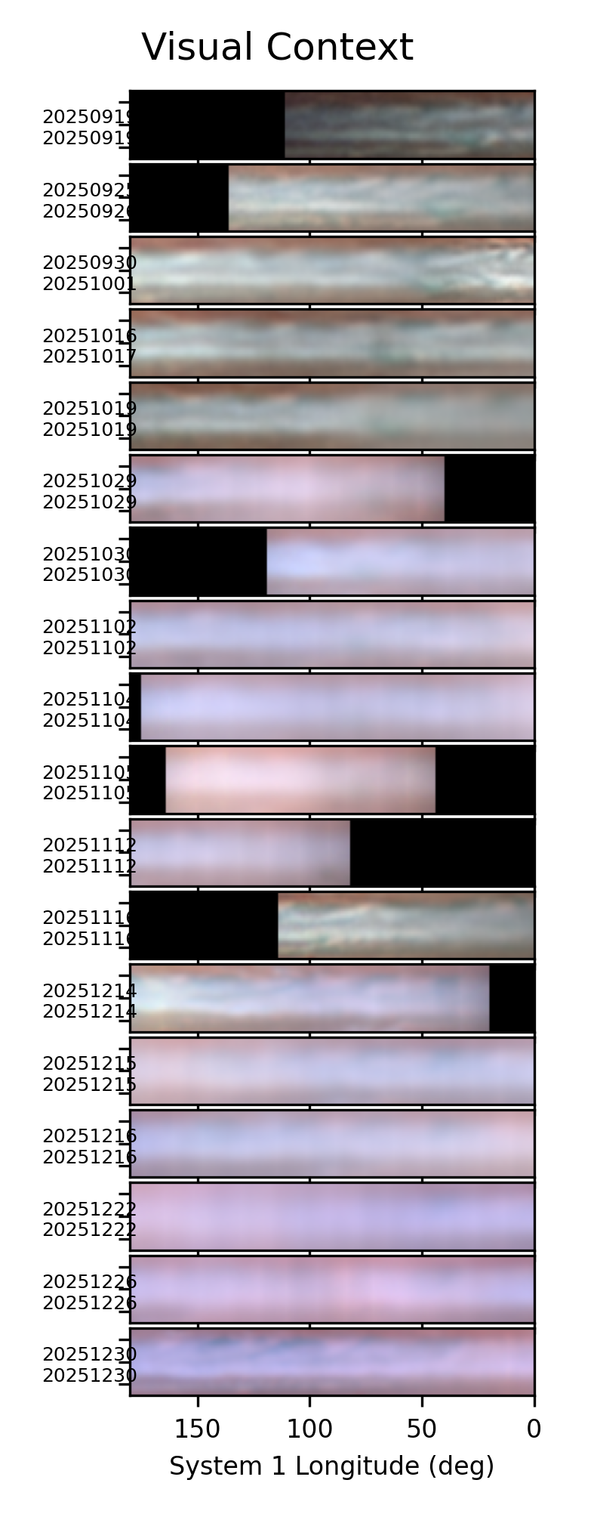
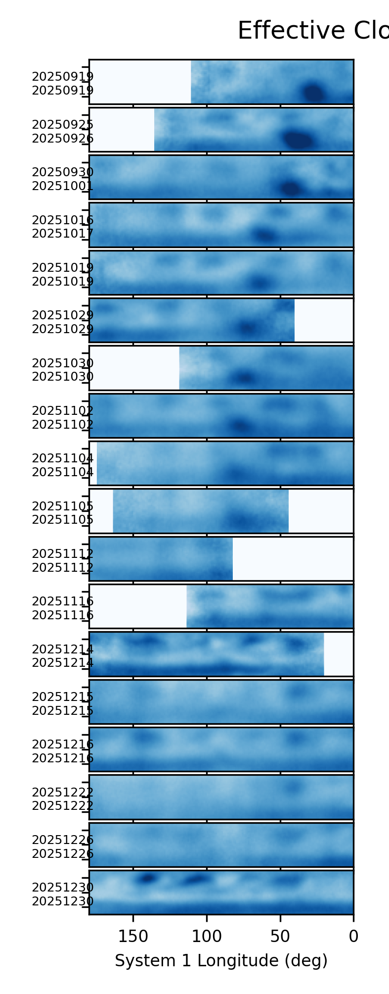
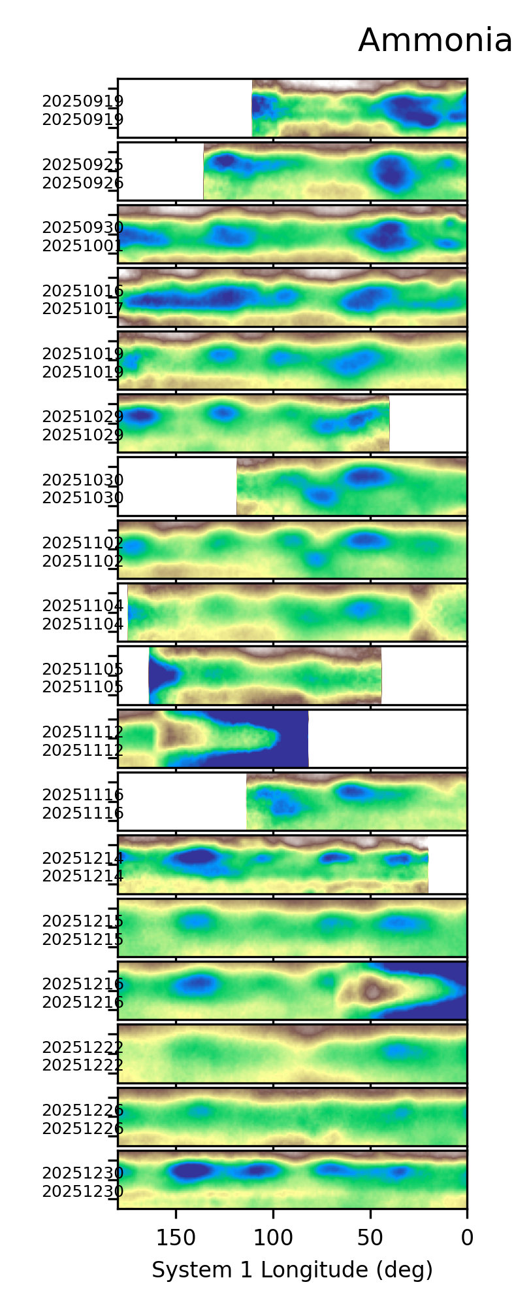
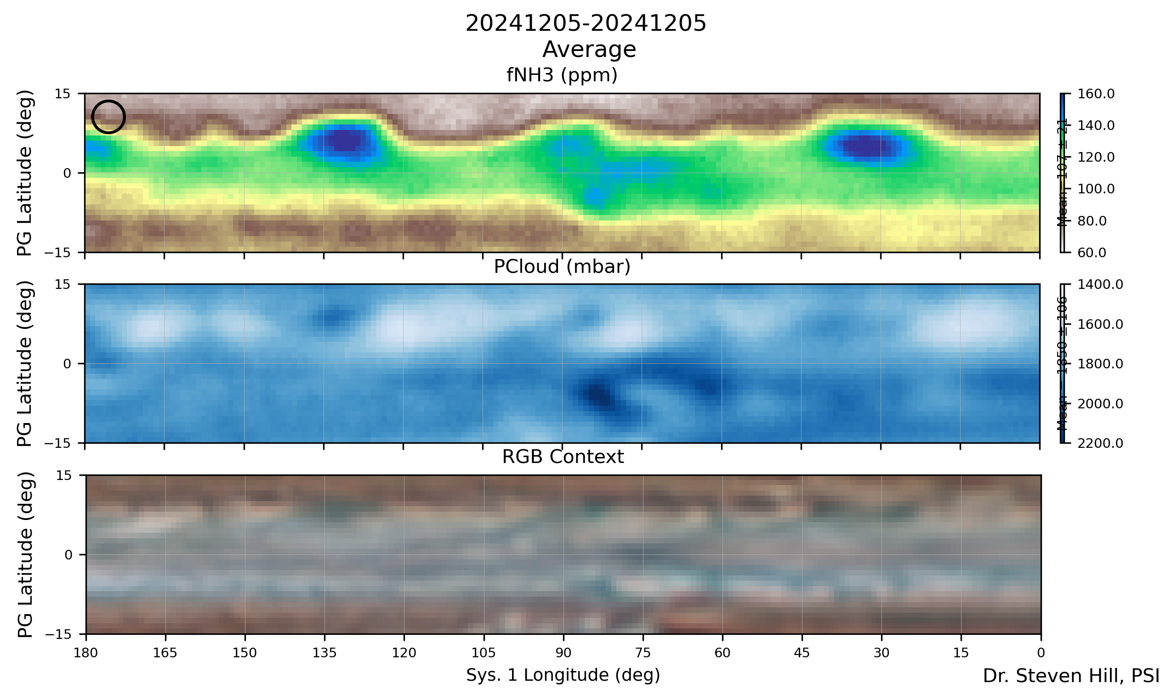
Basic Plot Products
Standard output plots, are those generated with no additional options selected
Individual plots for each L4 map (A)
Stack plots are created to show trends over time for features (B)
If 5-μm and/or 889-nm data are available they will be included
B)
A)
L4_map_script(collections=['SED2025_Fall’], LonSys='1',lats=[75,105],LonLims=[0,180], localmax=False, segment=False, variance=False,ctbls=['terrain_r','Blues'], proj='SED’, makemaps=False, cont=True,meridplot=False)

Slide 10
Top-Level Calling Script
All visualization and analysis functions can (or should be) callable from L4_map_scripy to run in a ‘batch’ mode
It’s possible to make the L4 maps as well using this script, but that is a dependency on another project/repo
L4 map functions should work on L3 files as well
L4_map_script.py
L4_map_script
make_L4_cont_maps.py
blendstack
make_map_frame_lims
make_5u_cont_map
createL4FileName
write_fits_contiguous_map
make_L4_cont_maps
L4_Jup_Map_Plot_V2.py
ApplyContours
RossbyWavePlot
figsize_and_aspect
set_up_figure
plot_optical_maps
plot_5u_map
plot_JALPO_map
make_bare_map
L4_Jup_Map_Plot_V2
L4 maps are composed of blended data from multiple observations Jupiter in the form of L3 maps. The L3 maps are corrected for limb-darkening and weighted blending is performed at each map location.

Slide 11
Top-Level Calling Script
TBD
get_map_collection
read_fits_map_L2_L3
make_patch
plot_patch
plot_contours_on_patch
find_extrema

Slide 12
Full Module Listing (1/3)
config_VA(planet="Jupiter")
find_blob(image_to_segment, intensity_image,threshold_abs=None, mode='max’)
find_extrema(data, min_distance=4, threshold_abs=None, mode='max')
flatten_patch(patch)
get_map_collection(collection)
L3_Jup_Map_Plot_V2(obskey="20251016UTa",target="Jupiter", CoLatLims=[45,135],LonRng=45,CMpref='subobs',LonSys='2',showbands=False, coef=[0.,0.],subproj='',figxy=[8.0,4.0],FiveMicron=False,plotoptions=["contours","surface"], ROI=False, LimbCorrection=False,dataversion=2,smoothcont=0)
L4_Jup_Map_Plot_V2(collection="20240129-20240202",IRTFcollection='20240205-20240205', CH4889collection="20240131-20240201",LonSys='1', LatLims=[0,180],LonLims=[0,360],figsz=[6.0,6.0],ROI=False, variance=False,localmax=False,segment=False, proj='AGU2025',ctbls=['terrain_r','Blues'], cont=False,bare_maps=False,cb=False, axNH3=False,axCH4=False,axRGB=False,axIRTF=False, axCH4889=False,axNH3vCloud=False,axNH3vIRTF=False, axIRTFvPCld=False,ax889vPCld=False,counter=0,countmax=0, waveplot=False,meridplot=False,CH4889plot=False, surfplot=False,L3style=False,smoothcont=0,dataversion=2)

Slide 13
Full Module Listing (2/3)
L4_map_script(collections=['HSTGO'],proj='',LonSys='1',lats=[75,105],LonLims=[0,360],localmax=False,segment=False,meridplot=False,variance=False,ctbls=['terrain_r','Blues'], makemaps=False,cont=True)
make_lat_lon_str(lats,LonLims)
make_patch(Map,LatLims,LonLims,CM,LonRng,pad=True)
map_and_context(mapdata,dateobs,bunit,filename,RGB,RGBtime,LonSys,LatLims,LonLimsWest,LonRng,PlotCM,amfdata,coef,low,high,showbands,FiveMicron,figxy,ct,pathout,Level='L3',suptitle="Test",cbar_rev=False,cont=False,cbar_title="Test", ROI=False,smoothcont=0,dataversion=2)
map_and_scatter(patchx,patchy,mapydata,dateobs,LonSys, LatLims,LonLimsWest,LonRng,PlotCM,fnout,amfdata,coef,txin,xlow,xhigh,ylow,yhigh,figxy,ct,pathout,Ltitle,Rtitle,Level='L3',cont=False,FiveMicron=False,cbar_rev=False,swap_xy=False,axis_inv=False,cbar_title="Test", suptitle="Test",ROI=False,smoothcont=0,dataversion=2)
map_and_scatter_SCubed(patchx,patchy,mapydata,RGBpatch,dateobs,LonSys,LatLims,LonLimsWest,LonRng,PlotCM,fnout,amfdata,coef,txin,xlow,xhigh,ylow,yhigh,figxy,ct,pathout,Ltitle,Rtitle,Level='L3',cont=False,FiveMicron=False,cbar_rev=False,swap_xy=False,axis_inv=False,cbar_title="Test",suptitle="Test",ROI=False,smoothcont=0,dataversion=2)
map_cloudsurface(PCld_patch,fNH3_patch_mb,RGB4Display, HDRCld, HDRfNH3, timeRGB, LonSys, LatLims,LonLims,LonRng,PlotCM,pathout, dataversion=2)
plot_ALL_blob_features(proj='NEZ',dataset="2024-2025 NEZ")
plot_contours_on_patch(ax,CH4Abs_conv,LatLims,LonLims, lvls=[0.71,0.73,0.75,0.77,0.79],frmt='%3.1e’, clr='w')

Slide 14
Full Module Listing (3/3)
plot_map_scatter(patch1,patch2,Real_CM2,LatLims,axscor,PCldlow,PCldhigh, fNH3low,fNH3high,FiveMicron,axis_inv=False,Bands=False, dataversion=2)
plot_patch(patch, LatLims, LonLims, CM2, LonRng, colorscale, axis, cbarplot=True, cbar_title="Test", cbar_reverse=False, vn=0.10, vx=0.20, n=6, alpha=1.0, cbarvis=True, anchor='W’)
plot_roi_scatter(patch1,patch2,Real_CM2,LatLims,LonLims,axscor,PCldlow,PCldhigh, fNH3low,fNH3high,FiveMicron,axis_inv=False,ROI=False,amfpatch=False, dataversion=2)
read_fits_map_L3_V2(obskey="20251016UTa",imagetype="Map",Level="L3", target="Jupiter",LonSys='3', LimbCorrection=False,dataversion=2)
ROI_Script(collection="20241202-20241202 NEDF 340",dateformat="%b:%d", ctbls=["terrain_r","Blues"], LatLims=[75,105],LonRng=20,LonSys='1',close=False,coefs=[0.75,0.45], localmax=False,writecatalog=False)

Slide 15
Map Routines Calling Trees
Needs major update since splitting creation, plotting, and analysis routines – SMH 2025-11-20
ROI_Script
L3_Jup_Map_Plot
MakeContiguousMap
get_map_collection
NEDF_ROI_collections

Slide 16
Map Routines Calling Trees
Needs major update since splitting creation, plotting, and analysis routines – SMH 2025-11-20
L3_Jup_Map_Plot
make_patch
read_fits_map_L2_L3
map_and_context
map_and_scatter

Slide 17
Map Routines Calling Trees
Can we make make_patch, plot_patch, and make_contours_CH4_patch all the same level of call and call them in sequence?
Can we set the color table for the map and scatter to “Blues” rather than greys
Can we provide an alternative that over plots in red and black only the most extreme contours of fNH3 and PCld? This would match what was developed for the EPSC abstract in
map_and_context
make_patch
plot_patch
plot_contours_on_patch
make_patch_RGB

Slide 18
Map Routines Calling Trees
Can we make make_patch, plot_patch, and make_contours_CH4_patch all the same level of call and call them in sequence?
Can we set the color table for the map and scatter to “Blues” rather than greys
Can we provide an alternative that over plots in red and black only the most extreme contours of fNH3 and PCld? This would match what was developed for the EPSC abstract in
map_and_scatter
make_patch
plot_patch
plot_contours_on_patch
plot_roi_scatter
plot_map_scatter

